Slide 1
Session – 6
Software Maintenance

Slide 2
Recap for session 5
Personal and Team Process models​
Personal Software Process (PSP) defines 5 framework activities
Team Software Process (TSP)
Product and Process
Difference between Product and Process:-

Slide 3
Agenda for session 6
Software Maintenance
Types of Software Maintenance
Cost of Software Maintenance
Maintenance Activities

Slide 4
Software Maintenance
Software maintenance is widely accepted part of SDLC now a days. It stands for all the modifications and updations done after the delivery of software product.
There are number of reasons, why modifications are required, some of them are briefly mentioned below:
Market Conditions - Policies, which changes over the time, such as taxation and newly introduced constraints like, how to maintain bookkeeping, may trigger need for modification.

Slide 5
Software Maintenance Cont..
Client Requirements - Over the time, customer may ask for new features or functions in the software.
Host Modifications - If any of the hardware and/or platform such as operating system of the target host changes, software changes are needed to keep adaptability.
Organization Changes - If there is any business level change at client end, such as reduction of organization strength, acquiring another company, organization venturing into new business, need to modify in the original software may arise

Slide 6
Types of Software Maintenance
Types of maintenance
In a software lifetime, type of maintenance may vary based on its nature. It may be just a routine maintenance tasks as some bug discovered by some user or it may be a large event in itself based
on maintenance size or nature.
Following are some types of maintenance based on their characteristics:
1. Corrective Maintenance –
This includes modifications and updations done in order to correct or fix problems, which are either discovered by user or concluded by user error reports.
2. Adaptive Maintenance –
This includes modifications and updations applied to keep the software product up-to date and tuned to the ever changing world of technology and business environment.

Slide 7
Types of Software Maintenance Cont..
3. Perfective Maintenance –
This includes modifications and updates done in order to keep the software usable over long period of time. It includes new features, new user requirements for refining the software and improve its reliability and performance.
4. Preventive Maintenance –
This includes modifications and updations to prevent future problems of the software. It aims to attend problems, which are not significant at this moment but may cause serious issues in future.

Slide 8
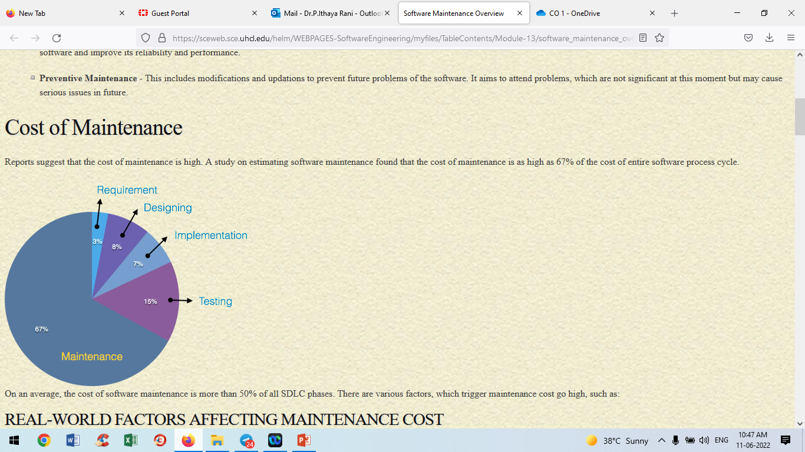
Cost of Software Maintenance
Cost of Maintenance
Reports suggest that the cost of maintenance is high. A study on estimating software maintenance found that the cost of maintenance is as high as 67% of the cost of entire software process cycle.
On an average, the cost of software maintenance is more than 50% of all SDLC phases.

Slide 9
Software Maintenance Cost…
There are various factors, which trigger maintenance cost go high, such as:
Real-world factors affecting Maintenance Cost
The standard age of any software is considered up to 10 to 15 years.
Older softwares, which were meant to work on slow machines with less memory and storage capacity cannot keep themselves challenging against newly coming enhanced softwares on modern hardware.
As technology advances, it becomes costly to maintain old software.
Most maintenance engineers are newbie and use trial and error method to rectify problem.
Often, changes made can easily hurt the original structure of the software, making it hard for any subsequent changes.
Changes are often left undocumented which may cause more conflicts in future.

Slide 10
Software Maintenance Cost…
Software-end factors affecting Maintenance Cost
1. Structure of Software Program
2. Programming Language
3. Dependence on external environment
4. Staff reliability and availability
These slides are designed to accompany Software Engineering: A Practitioner’s Approach, 7/e (McGraw-Hill 2009). Slides copyright 2009 by Roger Pressman.

Slide 11
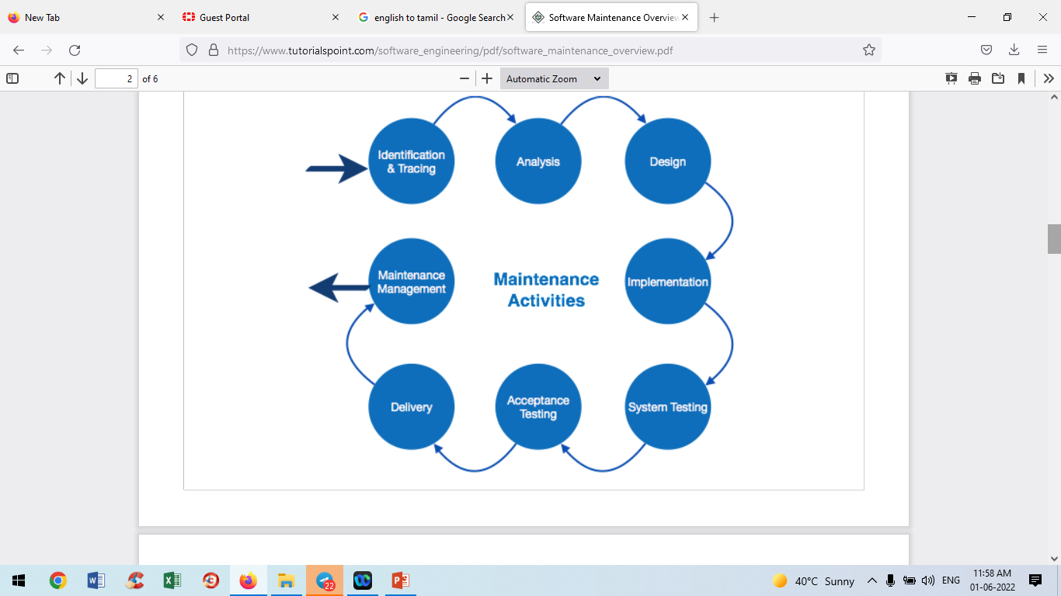
Maintenance Activities in Software Engineering
IEEE provides a framework for sequential maintenance process activities. It can be used in iterative manner and can be extended so that customized items and processes can be included.

Slide 12
Maintenance Activities in Software Engineering
These activities go hand-in-hand with each of the following phase:
1. Identification & Tracing –
It involves activities pertaining to identification of requirement of modification or maintenance.
It is generated by user or system may itself report via logs or
error messages.Here, the maintenance type is classified also.
These slides are designed to accompany Software Engineering: A Practitioner’s Approach, 7/e (McGraw-Hill 2009). Slides copyright 2009 by Roger Pressman.

Slide 13
Maintenance Activities in Software Engineering
2. Analysis –
The modification is analyzed for its impact on the system including safety and security implications. If probable impact is severe, alternative solution is looked for. A set of
required modifications is then materialized into requirement specifications. The cost of modification/maintenance is analyzed and estimation is concluded.
These slides are designed to accompany Software Engineering: A Practitioner’s Approach, 7/e (McGraw-Hill 2009). Slides copyright 2009 by Roger Pressman.

Slide 14
Maintenance Activities in Software Engineering
3. Design –
New modules, which need to be replaced or modified, are designed against requirement specifications set in the previous stage. Test cases are created for validation
and verification.
These slides are designed to accompany Software Engineering: A Practitioner’s Approach, 7/e (McGraw-Hill 2009). Slides copyright 2009 by Roger Pressman.

Slide 15
Maintenance Activities in Software Engineering
4. Implementation –
The new modules are coded with the help of structured design
created in the design step.
Every programmer is expected to do unit testing in parallel.
These slides are designed to accompany Software Engineering: A Practitioner’s Approach, 7/e (McGraw-Hill 2009). Slides copyright 2009 by Roger Pressman.

Slide 16
Maintenance Activities in Software Engineering
5. System Testing –
Integration testing is done among newly created modules. Integration testing is also carried out between new modules and the system.
Finally the system is tested as a whole, following regressive testing procedures.
6. Acceptance Testing –
After testing the system internally, it is tested for acceptance with the help of users. If at this state, user complaints some issues they are addressed or noted to address in next iteration

Slide 17
Maintenance Activities in Software Engineering
7. Delivery - After acceptance test, the system is deployed all over the organization either by small update package or fresh installation of the system. The final testing takes place at client end after the software is delivered.
Training facility is provided if required, in addition to the hard copy of user manual.
8. Maintenance management –
Configuration management is an essential part of system
maintenance. It is aided with version control tools to control versions, semi-version or patch management

Slide 18
Questions:
Software Maintenance includes
a) Error corrections
b) Enhancements of capabilities
c) Deletion of obsolete capabilities
d) All of the mentioned
2. Why do you need software maintenance?
Software maintenance is part of the software development life cycle. The purpose of the service is to modify and continuously update software applications to eliminate all possible errors, malfunctions, to improve work efficiency and better system performance

Slide 19
Maintenance is classified into how many categories ?
a) two
b) three
c) four
d) five
The modification of the software to match changes in the ever changing environment, falls under which category of software maintenance?
a) Corrective
b) Adaptive
c) Perfective
d) Preventive

Slide 20
What type of software testing is generally used in Software Maintenance?
a) Regression Testing
b) System Testing
c) Integration Testing
d) Unit Testing

